Slide 1
LEARNING UNIT 2 · ACTIVITY 2b
Client Rapport Assistant
with Human Handover
The agent drafts. A licensed human approves. Nothing sends unsupervised.
PLATFORM
APPROVAL
DURATION
Microsoft Copilot Studio
Microsoft Teams
90 minutes
Building AI Agents for Work Automation
Tertiary Infotech Academy Pte Ltd · UEN 201200696W

Slide 2
01
The Problem
Why Meridian cannot just automate this
LU2 · Activity 2b
© 2026 Tertiary Infotech Academy Pte Ltd
2

Slide 3
SCENARIO
Meridian Asset Management today
Clients write in scared
Replies take three days
One sentence is a breach
Six discretionary portfolios. When markets move, clients email — worried about performance, volatility and NAV. They are anxious about their own money.
The relationship managers are drowning. Some clients get a warm, careful answer. Some get a rushed one. Consistency is a matter of who was on duty.
A manager under pressure once wrote “don’t worry, it always bounces back.” That is unlicensed financial advice in every jurisdiction that has a regulator.
The team wants AI to reply faster. Compliance says no. Both are right.
LU2 · Activity 2b
© 2026 Tertiary Infotech Academy Pte Ltd
3

Slide 4
The AI is drafting a letter from a licensed firm
to a retail investor about their money.
Getting the tone wrong is embarrassing. Getting the content wrong — “hold on, it will recover” — is an offence.
LU2 · Activity 2b
© 2026 Tertiary Infotech Academy Pte Ltd
4

Slide 5
02
Human in the Loop
What the phrase actually means
LU2 · Activity 2b
© 2026 Tertiary Infotech Academy Pte Ltd
5

Slide 6
DEFINITIONS
Three patterns, often confused
HUMAN IN THE LOOP
ON / OUT OF THE LOOP
Who decides
AI proposes
AI decides
Who acts
Human authorises
AI acts
Can AI proceed alone?
No — it blocks
Yes
Supervision happens
Before the act
After, if at all
Failure mode
Delay
The client already read it
LU1's onboarding flow and LU2's investment advisor are both OUT of the loop. This lab is the only one genuinely IN it.
LU2 · Activity 2b
© 2026 Tertiary Infotech Academy Pte Ltd
6

Slide 7
THE SHAPE OF THIS WORKFLOW
Where the loop closes
Client writes
Agent works
▶ HUMAN ◀
Consequence
A worried message
arrives from the
website widget
Classify · read tone
flag · DRAFT
(never sends)
The run STOPS
until a person
acts in Teams
Send + log, or
assign a named
person to call
Everything before the gate is a proposal. Everything after it is a consequence. The node between them does nothing at all except wait.
LU2 · Activity 2b
© 2026 Tertiary Infotech Academy Pte Ltd
7

Slide 8
The test of a real gate:
submit an enquiry, then walk away.
The run says Running. It will still say Running tomorrow. Nothing times out, nothing defaults, nothing proceeds.
LU2 · Activity 2b
© 2026 Tertiary Infotech Academy Pte Ltd
8

Slide 9
03
What You Build
Eleven nodes, one gate
LU2 · Activity 2b
© 2026 Tertiary Infotech Academy Pte Ltd
9

Slide 10
COPILOT STUDIO
The workflow on the canvas
[missing screenshot: lu2b-10-flow-canvas.png]
LU2 · Activity 2b
© 2026 Tertiary Infotech Academy Pte Ltd
10

Slide 11
BUILD ORDER
The eleven nodes, in order
1
When a HTTP request is received
Anyone (no auth) · relative path blank · six-field schema
2
Normalise_Enquiry (Compose)
Ticket ID, trimmed name, lowercased email — the safety control
3
Rapport_Agent (Agent)
No knowledge source · temperature 0.2 · structured output
4
Response
Five fields back to the browser. The draft is not one of them
5
Log_Draft (Excel)
Thirteen columns. The draft exists; no human has seen it
Then four branch nodes: send + log on approve, assign + email on reject.
6
Human review
LU2 · Activity 2b
© 2026 Tertiary Infotech Academy Pte Ltd
11
Assigned to a licensed person · delivered in Teams
7
If/Else
Outcome Equals Approve

Slide 12
04
Inside the Agent
What it may and may not write
LU2 · Activity 2b
© 2026 Tertiary Infotech Academy Pte Ltd
12

Slide 13
SEVEN PROHIBITIONS
The non-advisory rule
Never recommend
Never predict
Buying, selling, holding, switching or redeeming anything
Future returns, prices or NAV — no forecasts, no estimates
Never guarantee
Never judge suitability
“Markets always recover” · “you will not lose money”
Not safe, not risky, not right for them
Never time the market
Never invent a figure
No comment on whether now is a good or bad moment
No fee, NAV or return that was not in the client's own message
And what it MAY do: name the emotion, restate the concern, explain the process, offer a call with a licensed manager.
LU2 · Activity 2b
© 2026 Tertiary Infotech Academy Pte Ltd
13

Slide 14
When in doubt, say less and offer the call.
That single sentence does more compliance work than the six prohibitions above it.
LU2 · Activity 2b
© 2026 Tertiary Infotech Academy Pte Ltd
14

Slide 15
WHAT THE AGENT RAISES
Six compliance flags
ADVICE_REQUESTED
asks what they should do
ESCALATE
GUARANTEE_SOUGHT
wants a promise about returns
ESCALATE
VULNERABLE_CLIENT
distress, illness, savings they cannot lose
ESCALATE
LEGAL_OR_MEDIA_THREAT
mentions a lawyer, MAS, the press
ESCALATE
COMPLAINT
dissatisfied with Meridian or its fees
log only
WITHDRAWAL_INTENT
raises redeeming or closing the account
log only
The four that escalate are the four that cannot be answered by a drafted email at all. For those, the correct output is a draft that says so.
LU2 · Activity 2b
© 2026 Tertiary Infotech Academy Pte Ltd
15

Slide 16
STRUCTURED OUTPUT · EIGHT FIELDS
The output contract
Custom structured output — not a Parse JSON node
{
"ticketId": "MAM-20260802-a607f8",
"concernCategory": "Portfolio Performance",
"emotionalTone": "Concerned",
"urgency": "Medium",
"complianceFlags": ["ADVICE_REQUESTED", "WITHDRAWAL_INTENT"],
"escalate": true,
"suggestedSubject": "Your enquiry about recent performance (MAM-...)",
"draftReply": "<p>Thank you for writing, and I am sorry ...</p>"
}
emotionalTone is a FIELD, not a paragraph. That is what lets you sort a queue and show a manager that the angriest client has waited longest. Prose cannot be sorted.
LU2 · Activity 2b
© 2026 Tertiary Infotech Academy Pte Ltd
16

Slide 17
A RULE THE MODEL CANNOT BREAK
Why structured output, not Parse JSON
With Text response you are asking and hoping
The model eventually wraps its answer in ```json fences, or opens with “Here is the JSON” — and the parse fails.
Structured output makes malformed JSON impossible
The schema is enforced at generation time. There is nothing to hope for.
Same discipline as the disclaimer
A rule the model physically cannot break beats a rule it is told not to break.
Reference it with a slash, not nested brackets
body('Rapport_Agent')?['structuredOutput/draftReply']
LU2 · Activity 2b
© 2026 Tertiary Infotech Academy Pte Ltd
17

Slide 18
05
The Gate
Node 6 — Human review
LU2 · Activity 2b
© 2026 Tertiary Infotech Academy Pte Ltd
18

Slide 19
HUMAN REVIEW · MESSAGE
What the approver is shown
[missing screenshot: lu2b-11-human-review.png]
LU2 · Activity 2b
© 2026 Tertiary Infotech Academy Pte Ltd
19

Slide 20
WHAT THE APPROVER FILLS IN
The two inputs
Outcome · choice
Name · text
Approve / Reject
Drives the If/Else branch.
⚠ Leave the DEFAULT BLANK.
Pre-filling it with ‘Approve’ turns
the gate into a rubber stamp with a
one-word setting nobody can see on
the canvas.
If a default is required, use Reject —
then inattention fails safe.
The approver types their own name.
Lands in the Approved By column of
the audit table.
⚠ It is SELF-DECLARED. The node
publishes no responder identity, so
nothing stops someone typing ‘Bob’.
A convention — where a captured
identity would be evidence.
LU2 · Activity 2b
© 2026 Tertiary Infotech Academy Pte Ltd
20

Slide 21
TEAMS · APPROVALS APP
Approving in Microsoft Teams
[missing screenshot: lu2b-12-teams-approval.png]
LU2 · Activity 2b
© 2026 Tertiary Infotech Academy Pte Ltd
21

Slide 22
06
The Client's View
What the browser is allowed to see
LU2 · Activity 2b
© 2026 Tertiary Infotech Academy Pte Ltd
22

Slide 23
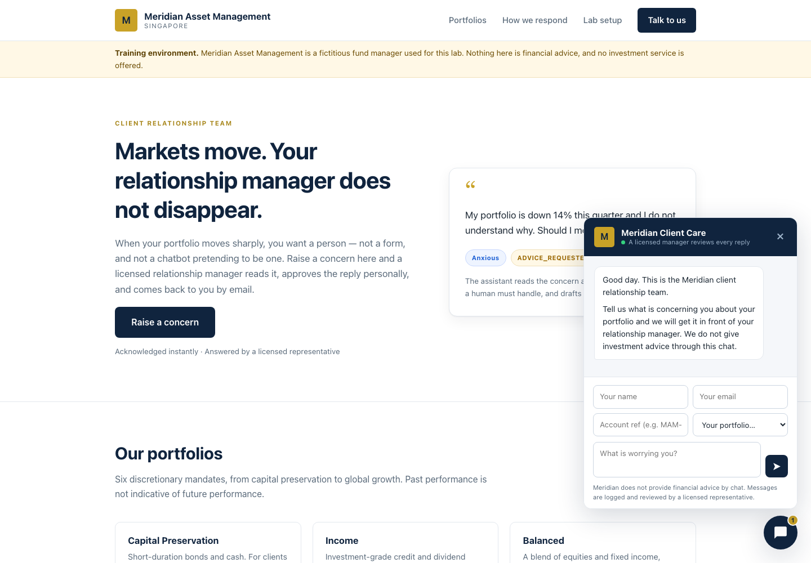
INDEX.HTML
The Meridian client portal
A floating chat widget on a single-page asset-management site. The lab configuration panel holds the workflow URL.
LU2 · Activity 2b
© 2026 Tertiary Infotech Academy Pte Ltd
23

Slide 24
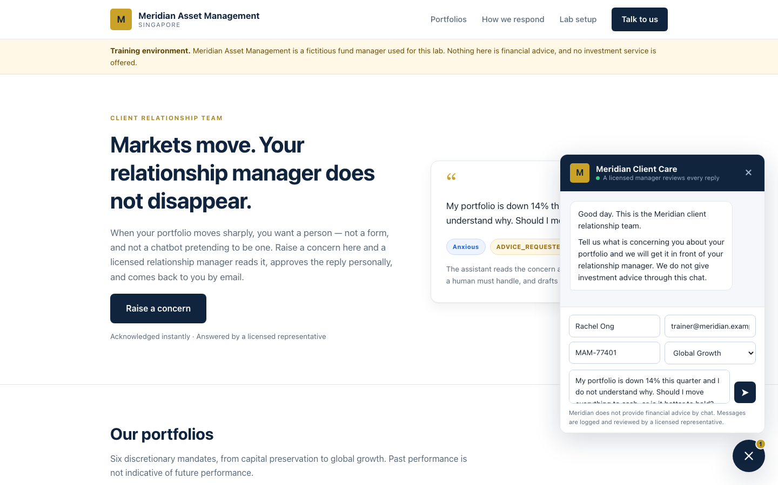
THE CHAT WIDGET
Raising a concern
Name, email, account reference and
portfolio — then the message.
The trainer dropdown fills all of it
except the email, which it clears
on purpose.
The approved reply is a REAL email.
Always use your own address.
LU2 · Activity 2b
© 2026 Tertiary Infotech Academy Pte Ltd
24

Slide 25
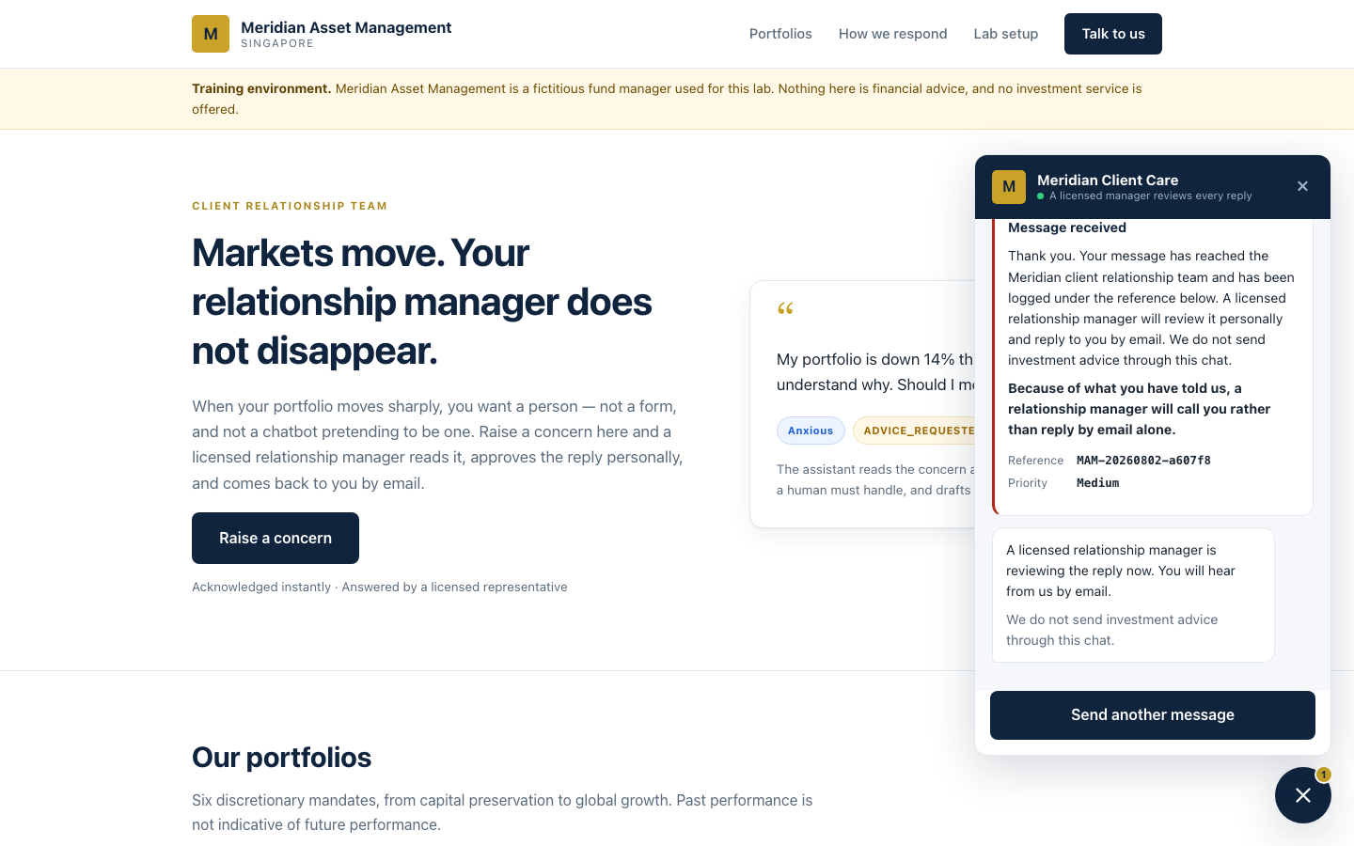
NODE 4 · RESPONSE
The receipt — and what is missing from it
Reference, priority, and — because
TC2 escalates — a line saying a
manager will call.
NOT returned: the draft itself,
emotionalTone, concernCategory,
complianceFlags.
“We have classified you as Angry and
flagged you as a COMPLAINT” is a
disclosure no compliance officer
would sign.
LU2 · Activity 2b
© 2026 Tertiary Infotech Academy Pte Ltd
25

Slide 26
Five fields go back to the browser.
The draft is not one of them.
The agent's assessment of a person is an internal record. The browser is not where it belongs.
LU2 · Activity 2b
© 2026 Tertiary Infotech Academy Pte Ltd
26

Slide 27
07
Run It
Eight test cases
LU2 · Activity 2b
© 2026 Tertiary Infotech Academy Pte Ltd
27

Slide 28
SAMPLE-QUERIES.CSV
The test matrix
TEST CASE
INPUT
EXPECTED
TC1 · Calm volatility
“dipped 6%, could someone explain?”
no flags → Approve
TC2 · Asks what to do
“Should I move everything to cash?”
ADVICE_REQUESTED
TC3 · Wants a guarantee
“promise I will not lose money”
GUARANTEE_SOUGHT
TC4 · Angry about fees
“furious · unacceptable · evasive”
COMPLAINT → Reject
TC5 · Wants to redeem
“redeem my entire holding”
WITHDRAWAL_INTENT
TC6 · Distressed retiree
“I am 68, cannot afford to lose this”
VULNERABLE → Reject
TC7 · Lawyer and MAS
“I have spoken to my lawyer”
LEGAL → Reject
TC8 · Factual NAV query
“how is the NAV calculated?”
no flags → Approve
Afterwards: Drafts has 8 rows, Approved_Replies has 5, Handover_Queue has 3.
LU2 · Activity 2b
© 2026 Tertiary Infotech Academy Pte Ltd
28

Slide 29
WHERE THE LESSON LANDS
Read the drafts, not just the flags
What a good TC2 draft does
What a bad TC2 draft does
Names the emotion in the first sentence.
Says plainly that the manager cannot give
a recommendation by email.
Offers a call with a licensed person.
Contains no figure the client did not
supply.
“Markets typically recover over the
long term.”
You have just watched a language model
commit a regulatory offence — in front
of the whole room.
And the approval gate caught it.
That is what it is for.
This is the most valuable failure in the lab. Do not fix it quietly.
LU2 · Activity 2b
© 2026 Tertiary Infotech Academy Pte Ltd
29

Slide 30
THE AUDIT TRAIL
Neither table has an empty accountability column
Approved_Replies names who authorised the email
That person is answerable for what reached the client.
Handover_Queue names who owes the client a call
A decline is a reassignment, not a deletion — the client is still waiting.
The regulator's question is not ‘what did the machine decide’
It is ‘which licensed person is answerable for it’.
Drafts records what the machine proposed, including rejected drafts
Asset or liability in litigation? Argue both sides in the debrief.
LU2 · Activity 2b
© 2026 Tertiary Infotech Academy Pte Ltd
30

Slide 31
08
What Goes Wrong
Field-tested
LU2 · Activity 2b
© 2026 Tertiary Infotech Academy Pte Ltd
31

Slide 32
DESIGNER QUIRKS
The four that cost the most time
There is no workflow() function in this designer
Unknown function: workflow. Use guid() for the ticket ID instead.
The Instructions box escapes underscores
A pasted reference becomes Normalise\_Enquiry, resolves to EMPTY, and the agent says ‘no enquiry was included’. Always use the ⚡ picker.
The Agent node has no separate user-message field
The enquiry is appended to the END of the Instructions.
assignedTo must be a tenant user, picked from the dropdown
External addresses and tabbed-away text both fail at runtime with BadRequest.
LU2 · Activity 2b
© 2026 Tertiary Infotech Academy Pte Ltd
32

Slide 33
CONFIGURATION TRAPS
Two that change behaviour silently
escalated must be UNQUOTED in the Response body
Quoted, it returns the string “false” — and Boolean(“false”) is true. Every calm client is told a manager is calling.
Compliance Flags must be wrapped in join()
It is an array. Without join() Excel writes System.Object[] and the audit column is useless.
Web search must be OFF
On, the agent can pull live market commentary into a client letter. One toggle undoes the entire non-advisory rule.
If the approval never arrives, switch Channel to Teams
The Outlook route silently fails to deliver on some tenants while the run still shows Running.
LU2 · Activity 2b
© 2026 Tertiary Infotech Academy Pte Ltd
33

Slide 34
09
Debrief
The questions worth arguing about
LU2 · Activity 2b
© 2026 Tertiary Infotech Academy Pte Ltd
34

Slide 35
DISCUSSION
Ask these before anyone packs up
1
TC6 is the hard one
Should a distressed 68-year-old's enquiry have reached the AI at all?
2
The approval button is a rubber stamp
After forty of these, what makes careful reading the path of least resistance?
3
emotionalTone is a judgement about a person, in a spreadsheet
Under the PDPA, is that personal data? Who can see it? How long is it kept?
4
Three controls, ranked
Which is probabilistic, which procedural, and which structural?
5
Approved By is self-declared
Is that an audit trail? What would close the gap?
It is not the technology, and it is not the chance of the model being wrong.
6
Compare with LU1 and Activity 2
LU2 · Activity 2b
© 2026 Tertiary Infotech Academy Pte Ltd
35
Same platform, same shape, no gate. What is the actual variable?

Slide 36
The variable is not how likely the model is to be wrong.
It is what a wrong sentence costs — and to whom.
Generalities to the public can go unsupervised. This client's money cannot.
LU2 · Activity 2b
© 2026 Tertiary Infotech Academy Pte Ltd
36

Slide 37
10
Going Further
Where this goes next
LU2 · Activity 2b
© 2026 Tertiary Infotech Academy Pte Ltd
37

Slide 38
EXTENSIONS
If you had another day
Make rejection informative
Route before the model sees it
Close the identity gap
Add a required Comments input on reject. Right now Handover_Queue records that a draft was refused but never why — every Status cell says the same sentence.
A keyword pre-filter that sends distress straight to a human, with no draft at all. What does it cost, and what does it buy?
The node will not tell you who approved. What would you have to build to capture it — and is an audit trail you must remember to maintain an audit trail at all?
LU2 · Activity 2b
© 2026 Tertiary Infotech Academy Pte Ltd
38

